Slide 1
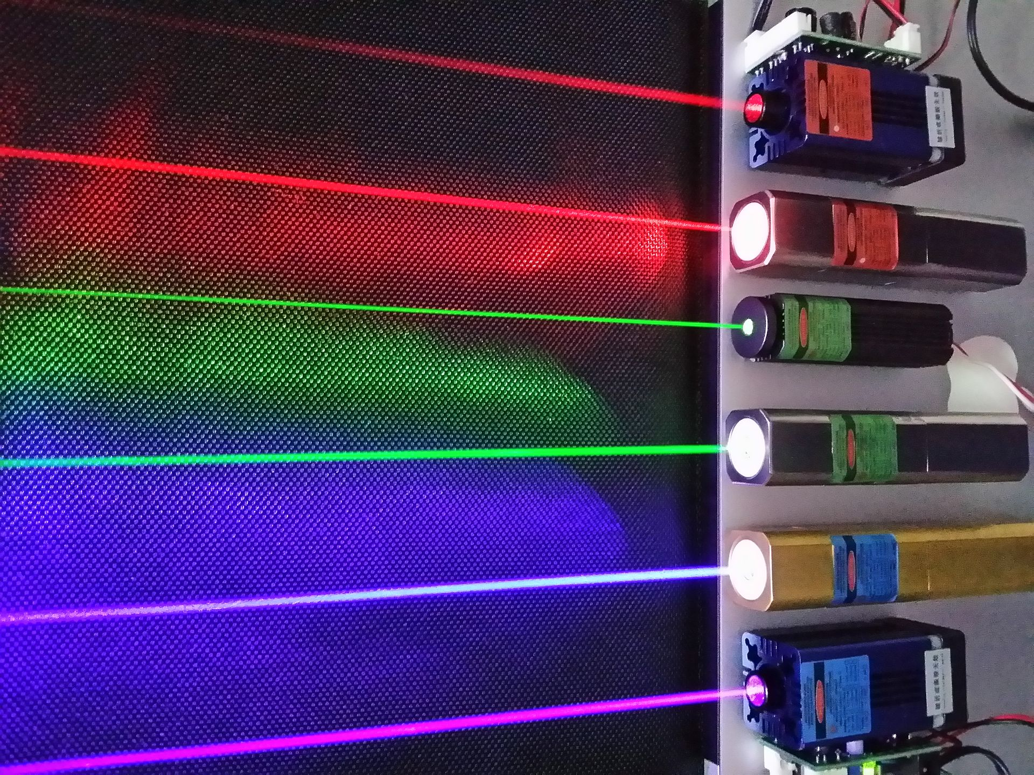
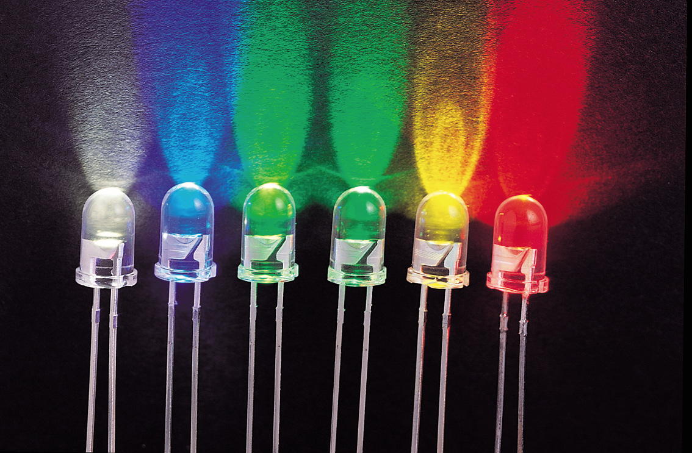
ELEE 4145 Lecture 2: Laser and LED
Laser
LED
by Mable Fok
Some of the lecture materials are from PU and CUHK.
Acknowledgement:
Prof. Prucnal from Princeton University
Prof. Shu from the Chinese University of Hong Kong

Slide 2
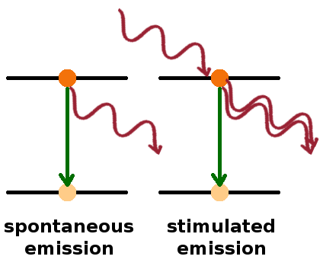


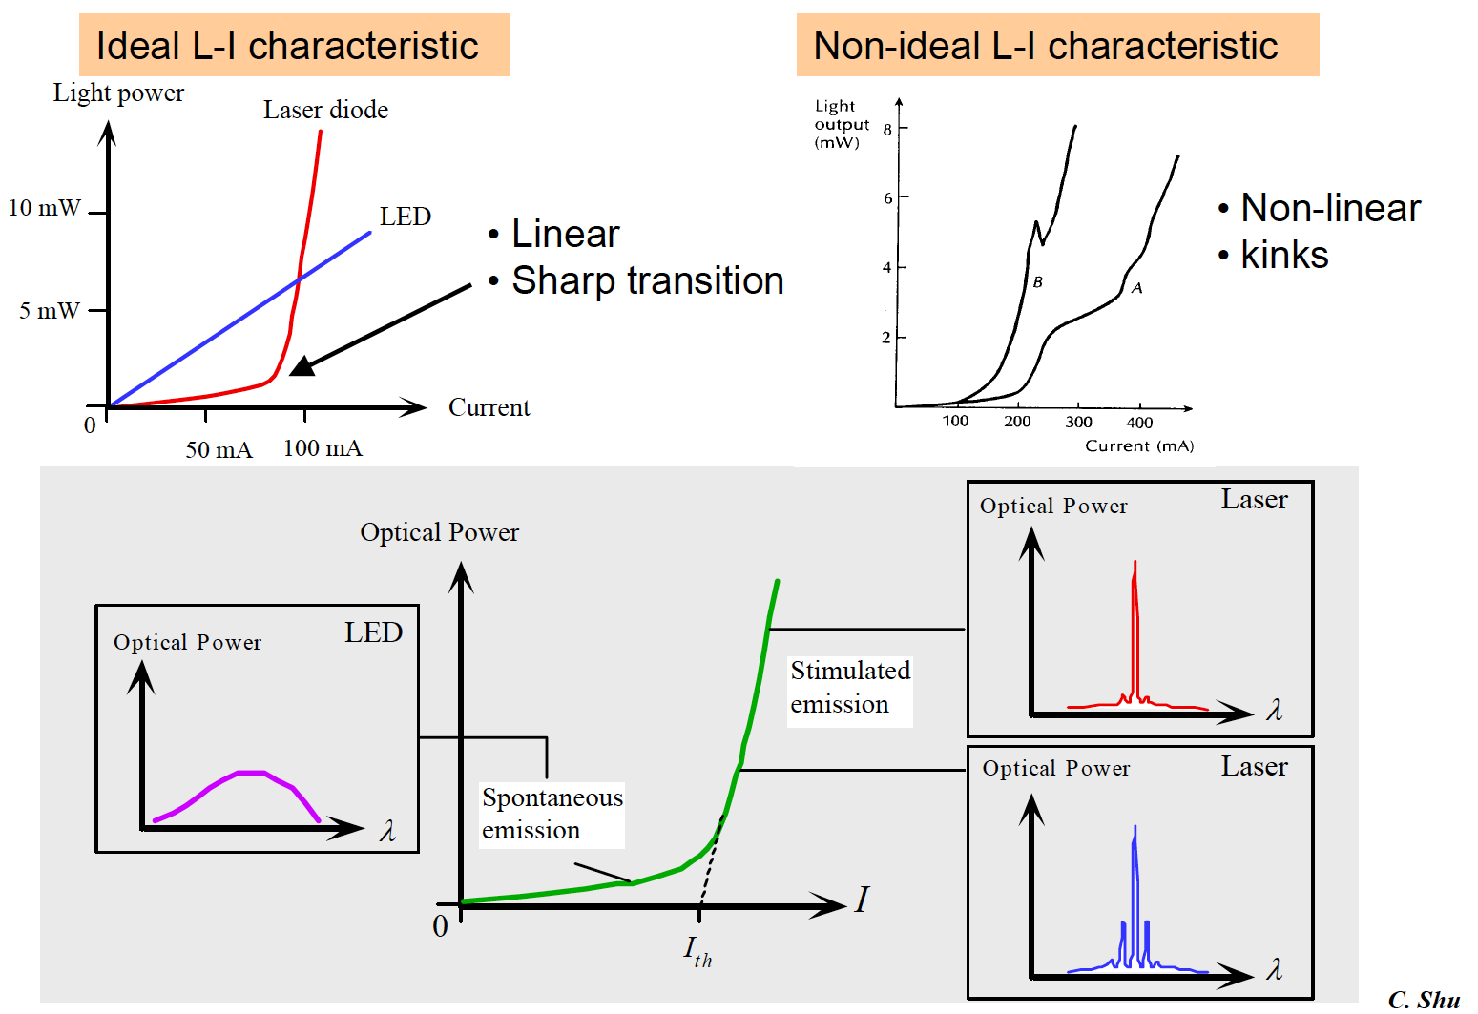
Laser vs. LED
LASER(Light Amplification by Stimulated Emission of Radiation)
LED(Light Emitting Diode)
We’ll explain these properties later in this chapter!
LED | Laser
Spontaneous emission | Stimulated emission
Non-coherent radiation | Coherent radiation
Multi-mode | Multi- and single mode
Wide spectral width | Narrow spectral width
Relatively low power | High power
Non-threshold device | Threshold device

Slide 3
Laser vs. LED
LASER(Light Amplification by Stimulated Emission of Radiation)
LED(Light Emitting Diode)
We’ll explain these properties later in this chapter!
LED | Laser
Low efficiency | High efficiency
Low modulation bandwidth | High modulation bandwidth
Short distant communication | Short and long distant commun.
Simple to fabricate | Relatively difficult to fabricate
Long life time | Shorter lifetime
Cheap | Expensive

Slide 4
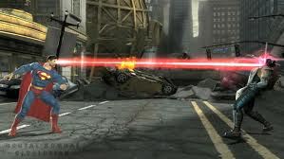
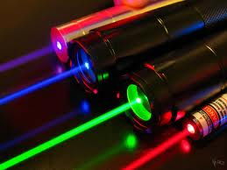

Where Can You Find Lasers?

Slide 5
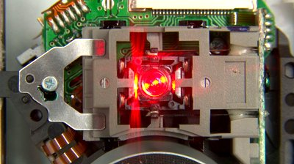
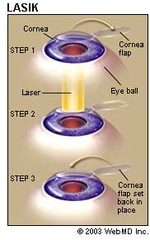

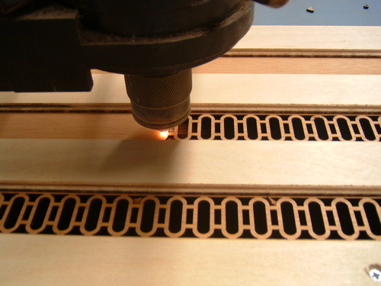
Where Can You Find Lasers?

Slide 6
Laser in Advanced Technology
Lasers are used in many areas, for example:
Industry
Measuring, drilling, cutting
Main advantage: no mechanical contact
Environmental applications
Waste water purification, to determine toxins in smoke
Sensing – spectroscopy
Research tool in physics, chemistry, biology, astronomy, etc…
Medicine
Ophthalmology, precision eye surgery, diagnostics
Communication and computing
Terrestrial telecom, satellite, military, etc
Data storage, optical disc recording

Slide 7
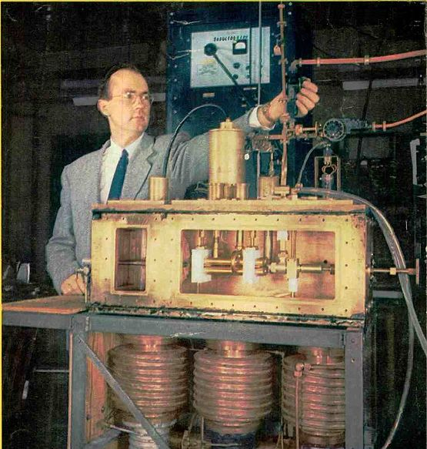
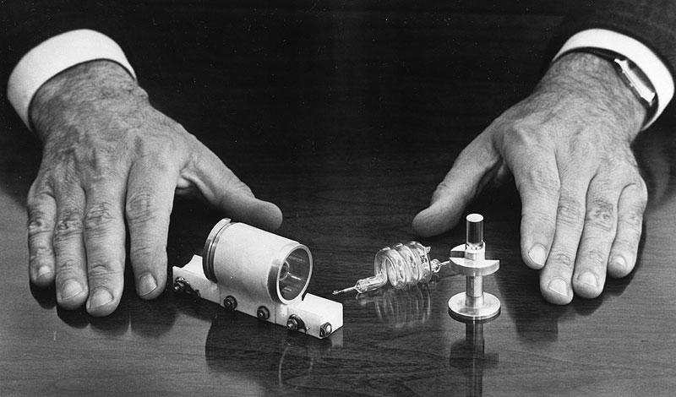
Laser History
1916: Theoretical background of laser action
(stimulated emission) developed by Einstein
1954: C.H. Townes et al. developed the MASER
Microwave Amplifier by Stimulated Emission of Radiation
Masers are used as the timekeeping device in atomic clocks
Frequency in the order of tens of GHz
1958: A. Schawlow and C. H. Townes adapted MASER to optical frequencies
1960: T.H. Maiman build the first laser
ruby laser
Other lasers (HeNe etc.) followed rapidly using different media
MASER
First Ruby Laser

Slide 8
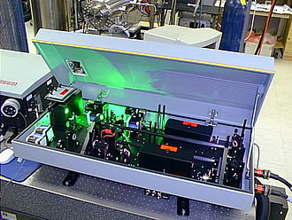
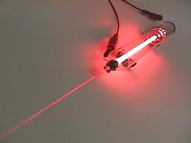
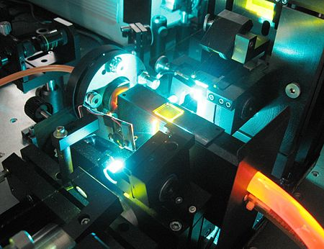
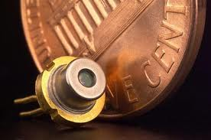
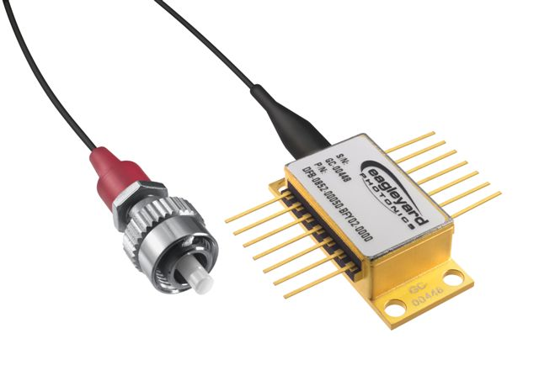
Different Types of Laser
Solid-state lasers, e.g. Nd:YAG Laser
Gas lasers, e.g. He Ne Laser
Table-top dye laser
Semiconductor Laser

Slide 9
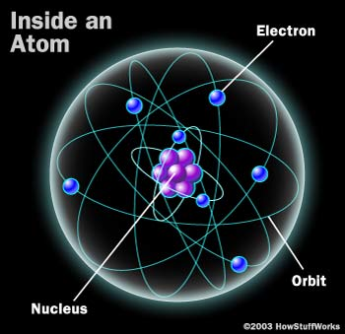
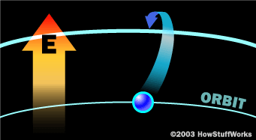
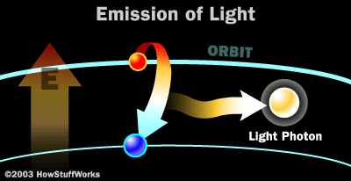
How LED Works?
An atom, in the simplest model, consists of a nucleus and orbiting electrons.
For a LED:
Step 1: Absorption
An atom absorbs energy in the form of heat, light, or electricity. Electrons move from a lower-energy orbit to a higher-energy orbit.
Step 2: Spontaneous emission
Once an electron moves to a higher-energy orbit, it eventually wants to return to the ground state.
When it does, it releases its energy as a photon -- a particle of light.
Ref: How Stuff Works?

Slide 10
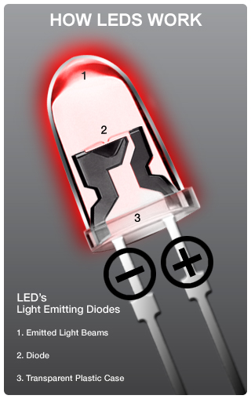
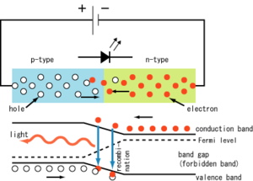
How LED and Laser Works?
Solid package of the LED can be designed to focus its light.

Slide 11
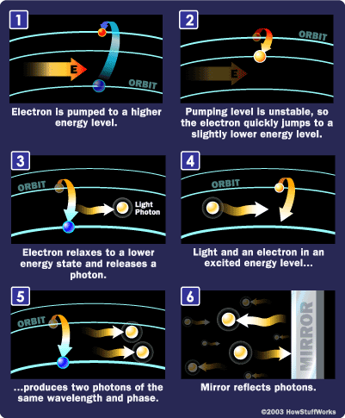
How Laser Works?
For a Laser:
Step 1:
Absorption
Step 2:
Spontaneous Emission
Step 3:
Stimulated Emission
(population inversion is needed)
Step 4:
Feedback and Amplification in Cavity
Step 1a
Step 1b
Step 2a
Step 2b
Step 3a
Step 3b

Slide 12
What is Population Inversion?
In thermal equilibrium, the density of excited electrons is very small. Most photons incident on the system will be absorbed, without the opportunity to stimulated an excited electron to go to ground state.
→ Thus, most emission is negligible.
Stimulated emission will exceed absorption only if the population of the excited states is greater than that of the ground state. Known as population inversion.
Population inversion is not an equilibrium state, thus, external pumping is needed (optically or electrically pumped).

Slide 13
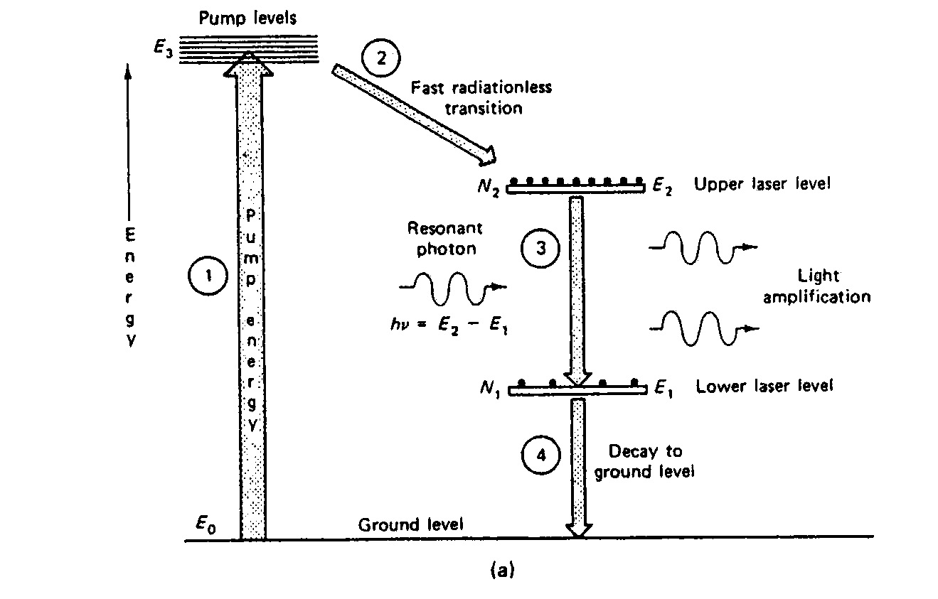
Four Level Laser System (e.g. HeNe)
Long lifetime
Short lifetime

Slide 14
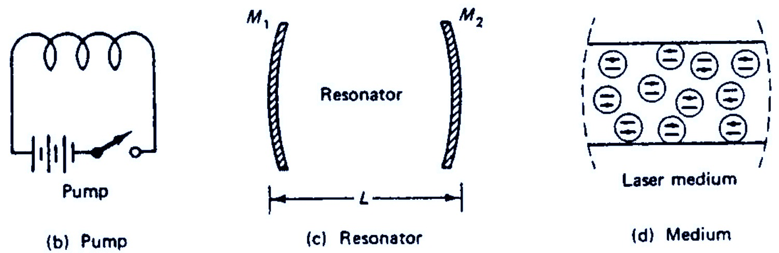
Amplification in Laser
Stimulated emission can lead to amplification
Net gain (signal build up) requires population inversion so that gain>loss
Two essential elements to achieve population inversion:
An external energy source or pump (electrical, optical, chemical)
An amplifying medium
An optical cavity or resonator, provides feedback, oscillation at a particular frequency, and increased gain.

Slide 15
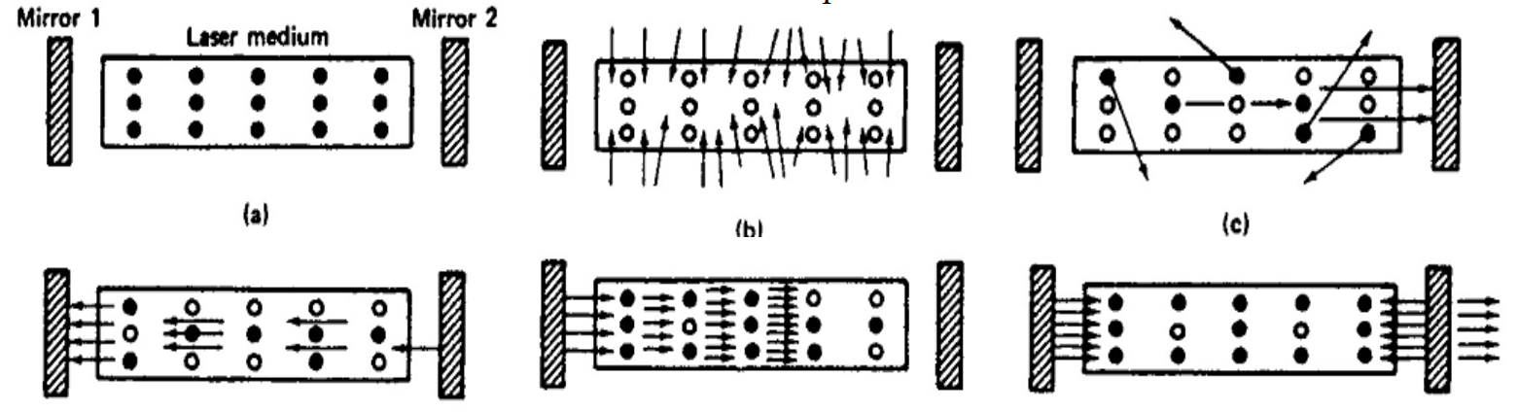
Laser Dynamic – Steps for Establishing Laser Operation
Start with a quiescent Laser
Start pumping the gain medium to obtain population inversion
Spontaneous emission begins to occur – produces seed photons
Light from seed photons leads to stimulated emission and gain
Cavity confines and directs stimulated photons – feedback increases light amplification in resonator
Light coupled out through partially reflecting mirror – lasing occurs when gain exceeds losses
(1)
(2)
(3)
(4)
(5)
(6)

Slide 16
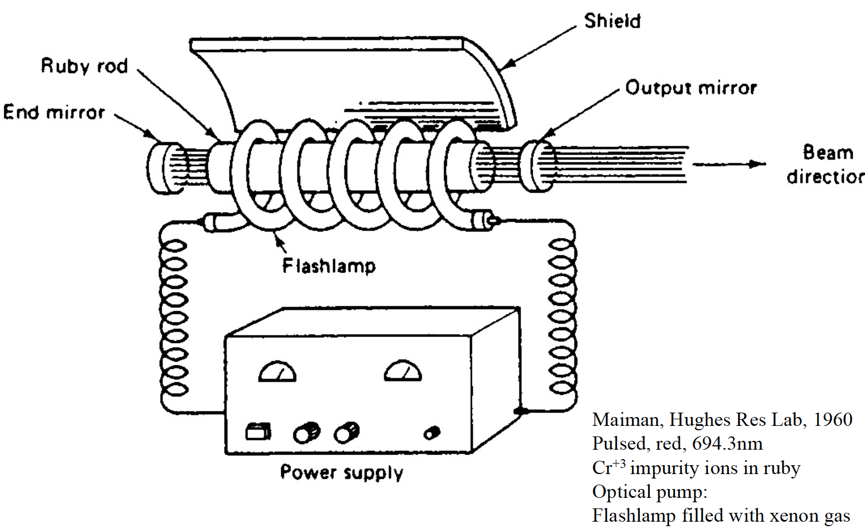
Ruby Laser System
Video
https://www.youtube.com/watch?v=oUEbMjtWc-A

Slide 17
Laser Power vs Current (L-I) Characteristic

Slide 18
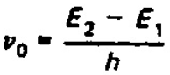
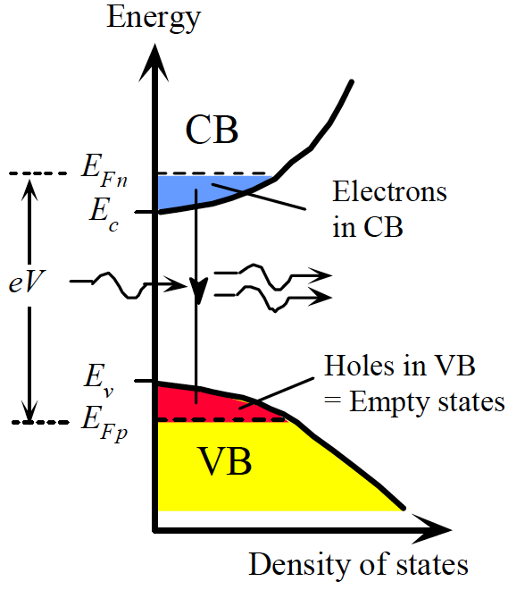
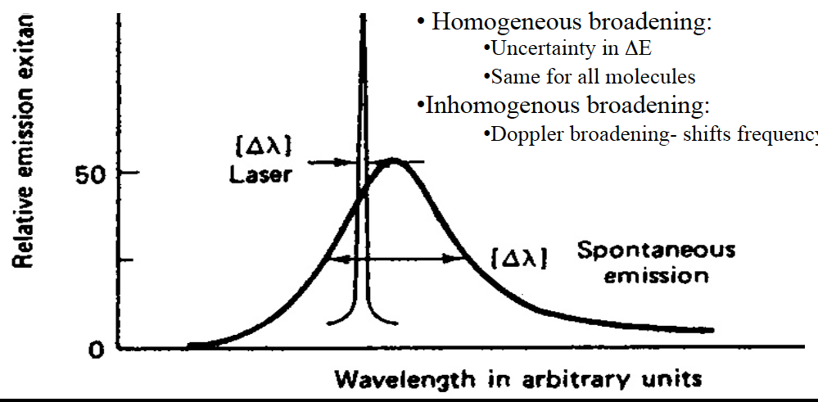
Lasing Wavelength and Spectra (I)
Photon wavelength (λ) or frequency (υ₀) inside the laser is determined by the energy level of the laser:
→ continuous over a wavelength range
h is the Planck's constant
h = 6.626 × 10 -34 joule·s

Slide 19
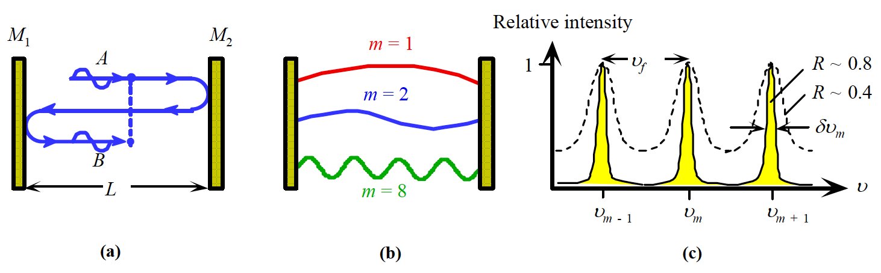
Lasing Wavelength and Spectra (II)
Lasing wavelength/frequency of the laser also determined by the cavity resonates.
Laser wavelength (Longitudinal modes) are determined by the condition that the round-trip cavity length is an integral number of wavelengths:
2n_{eff}L = mλ
where L is the cavity length and n_{eff} is the refractive index
Lasing condition:
Only those modes will lase for which the gain exceeds the cavity loss
Most laser are in a Fabry-Perot (FP) optical cavity. Its properties are:
(a) Reflected waves interfere.
(b) Only standing EM waves, modes, of certain wavelengths are allowed in the cavity.
(c) Intensity vs. frequency for various modes. R is mirror reflectance.

Slide 20
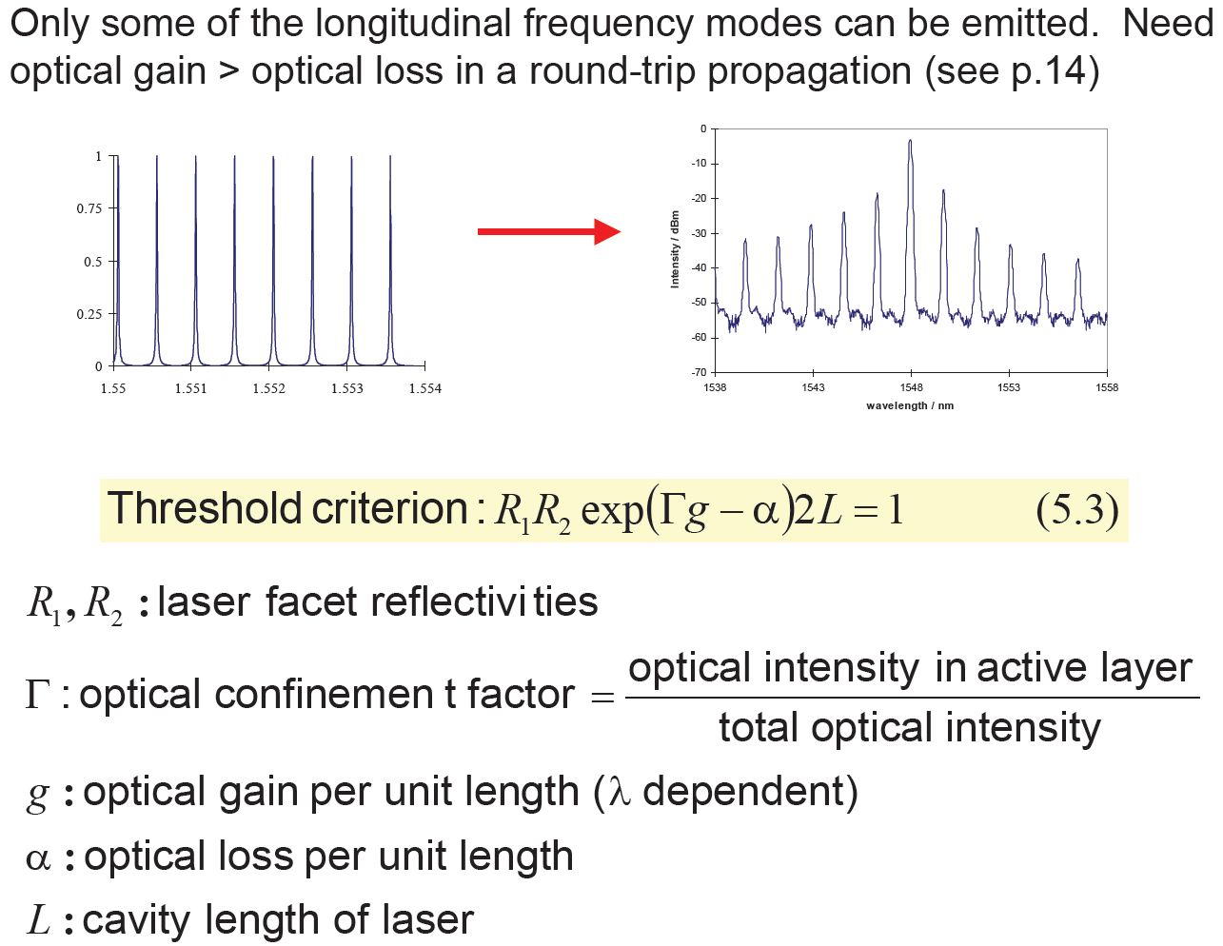
Lasing Wavelength and Spectra (III)
with infinity gain profile (do not exist)
Combining the effects of the two previous slides (gain profile + mode condition)
λ
λ

Slide 21
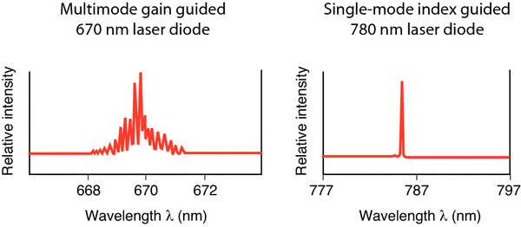
Single Mode vs Multimode Laser
Single mode laser means only one single wavelength is lasing, while multimode laser means multiple wavelength is lasing
Why do we want Single-Mode Laser?
Minimize optical spectral width to reduce dispersion-induced pulse broadening (i.e. different wavelength propagating at different speed. We will talk about dispersion in “optical fiber” chapter)
Allow the realization of wavelength-division-multiplexing communications (using different wavelength for different user)

Slide 22
Single Mode Oscillation (I)
Four common techniques for making a single mode laser
(i) Short Fabry-Perot (F-P) cavities
eg. vertical cavity surface emitting lasers - VCSELs
Short length lead to wide mode spacing
Adjacent cavity modes lie outside gain/feedback spectral range
Long Cavity
Short Cavity
Gain
Multi-mode
Single Mode
Ref: Dr. Huang

Slide 23
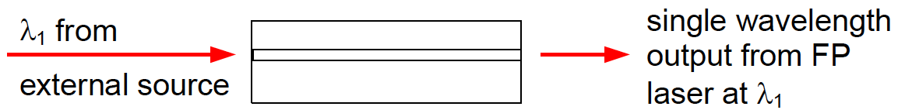
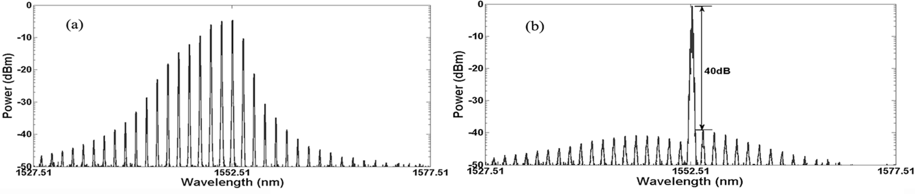
Single Mode Oscillation (II)
Four common techniques for making a single mode laser
(i) Short Fabry-Perot (F-P) cavities
eg. vertical cavity surface emitting lasers - VCSELs
Short length lead to wide mode spacing
Adjacent cavity modes lie outside gain/feedback spectral range
(ii) Injection locking/seeding of a FP laser
External optical injection of a single wavelength will increase the photon population for that mode and increases its stimulated emission
Requires matching of F-P modes with the injected wavelength

Slide 24
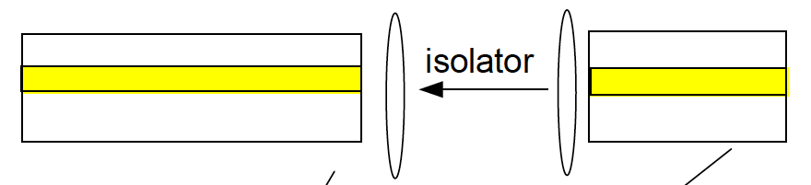
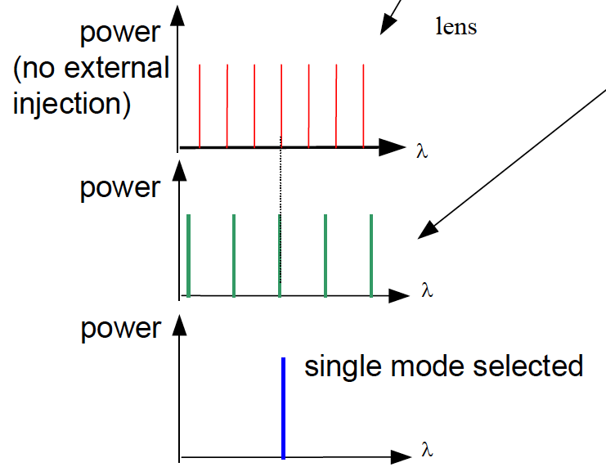
Single Mode Oscillation (III)
(iii) Multiple cavity lasers
The spectral comb of two independent cavities match only at a single wavelength inside the gain spectrum of the laser (Vernier effect).
Laser 2
lens
Laser 1

Slide 25
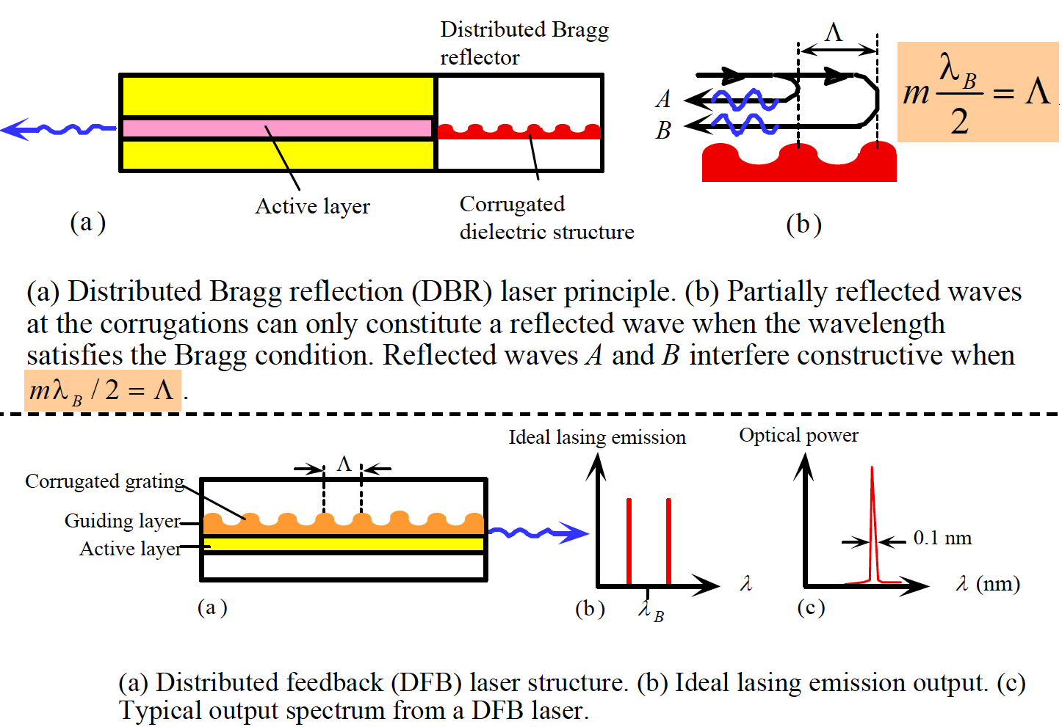
Single Mode Oscillation (IV)
(iv) Lasers with integrated gratings (DBR and DFB lasers)

Slide 26
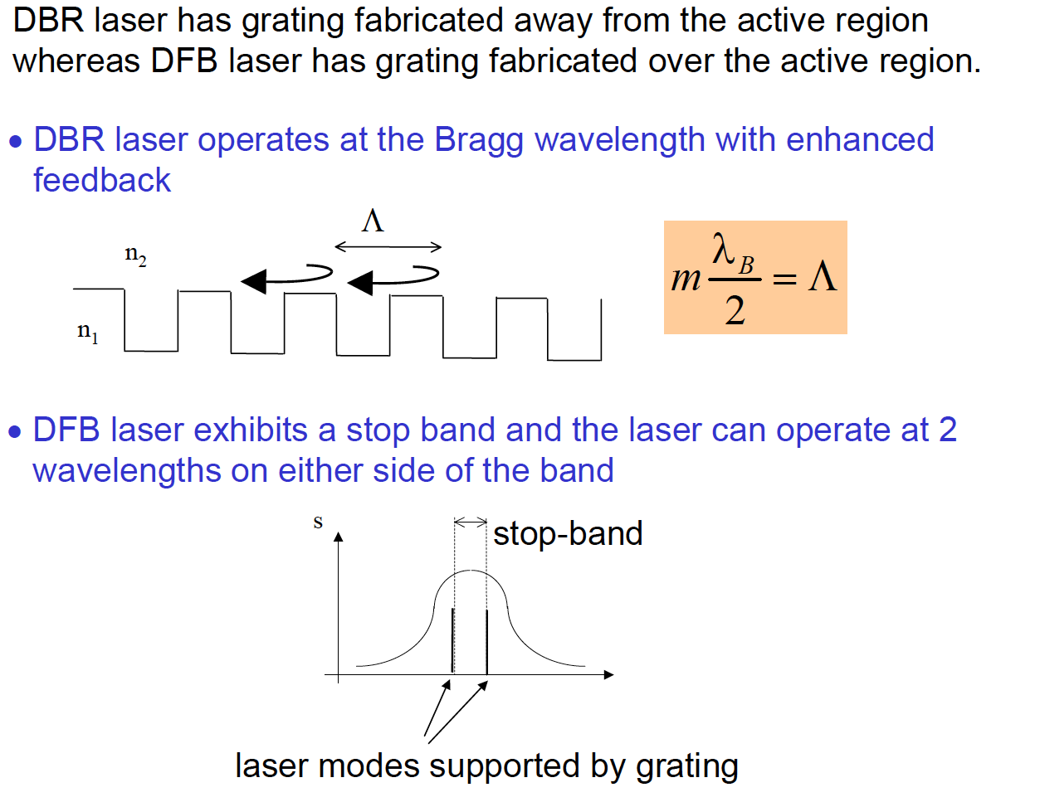
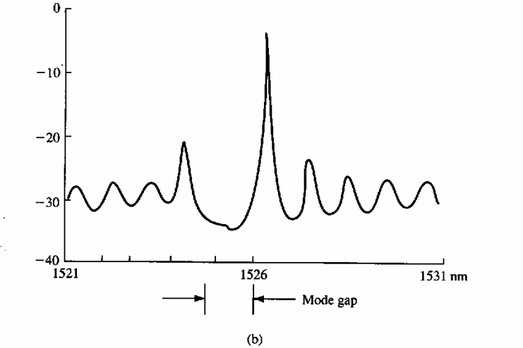
Single Mode Oscillation (V)

Slide 27
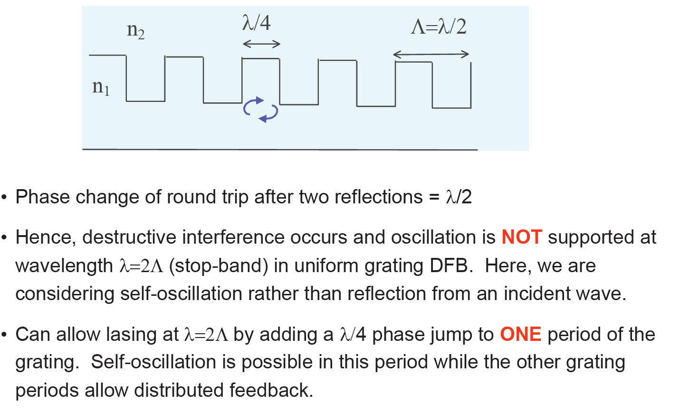
Single Mode Oscillation (VI)
See next page!

Slide 28
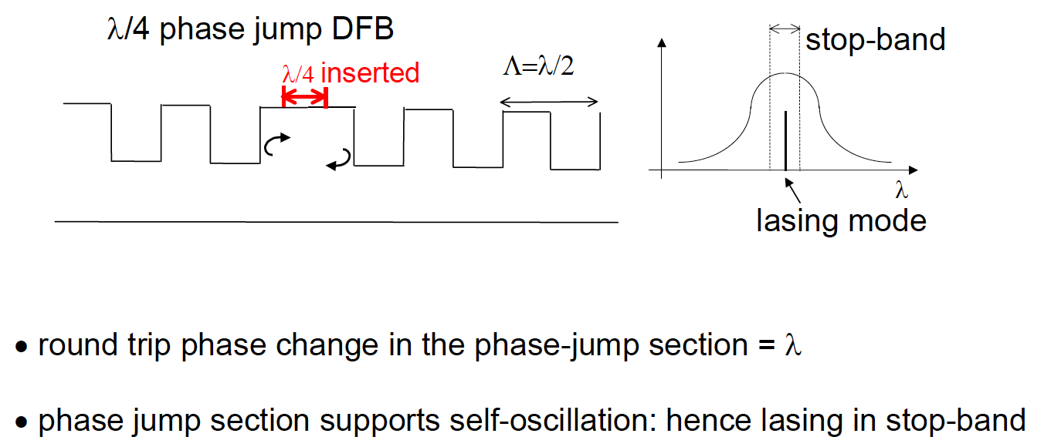
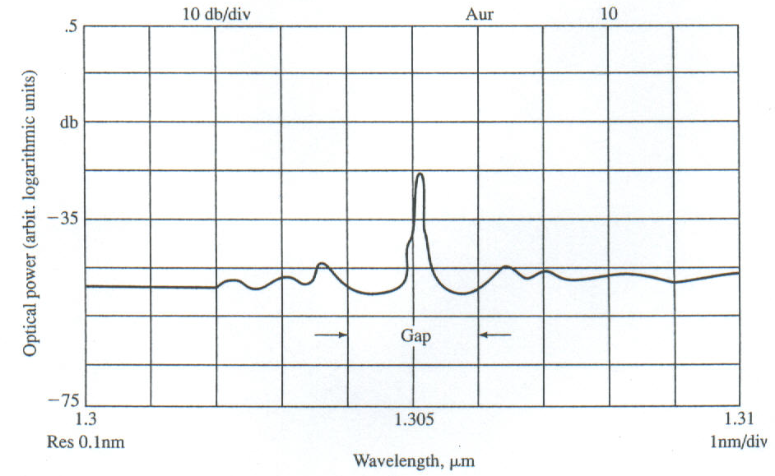
Single Mode Oscillation (VII)

Slide 29
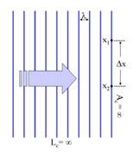
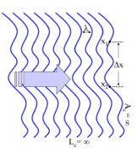
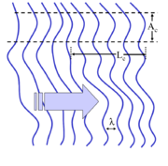
Laser Coherency
Two types of coherence:
Temporal coherence: a measure of the degree of monochromaticity of the light, describes the correlation or predictable relationship between signals observed at different moments in time; due to stimulated emission
The measure of the average correlation between the value of a wave and itself delayed by τ, at any pair of times.
Spatial coherence: a measure of the uniformity of the phase across the optical wave front; it describes the correlation between signals at different points in space.
describes the ability for two points in space, x1 and x2, in the extent of a wave to interfere, when averaged over time
A plane wave with an infinite coherence length.
A wave with a varying profile (wavefront) and infinite coherence length.
A wave with a varying profile (wavefront) and finite coherence length.

Slide 30
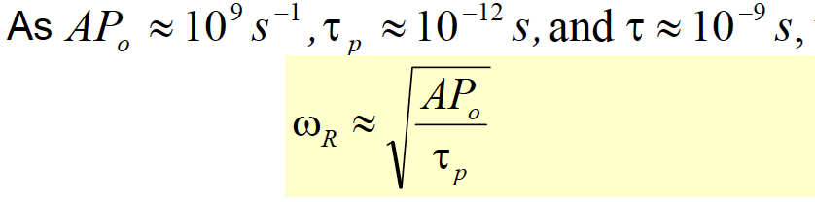
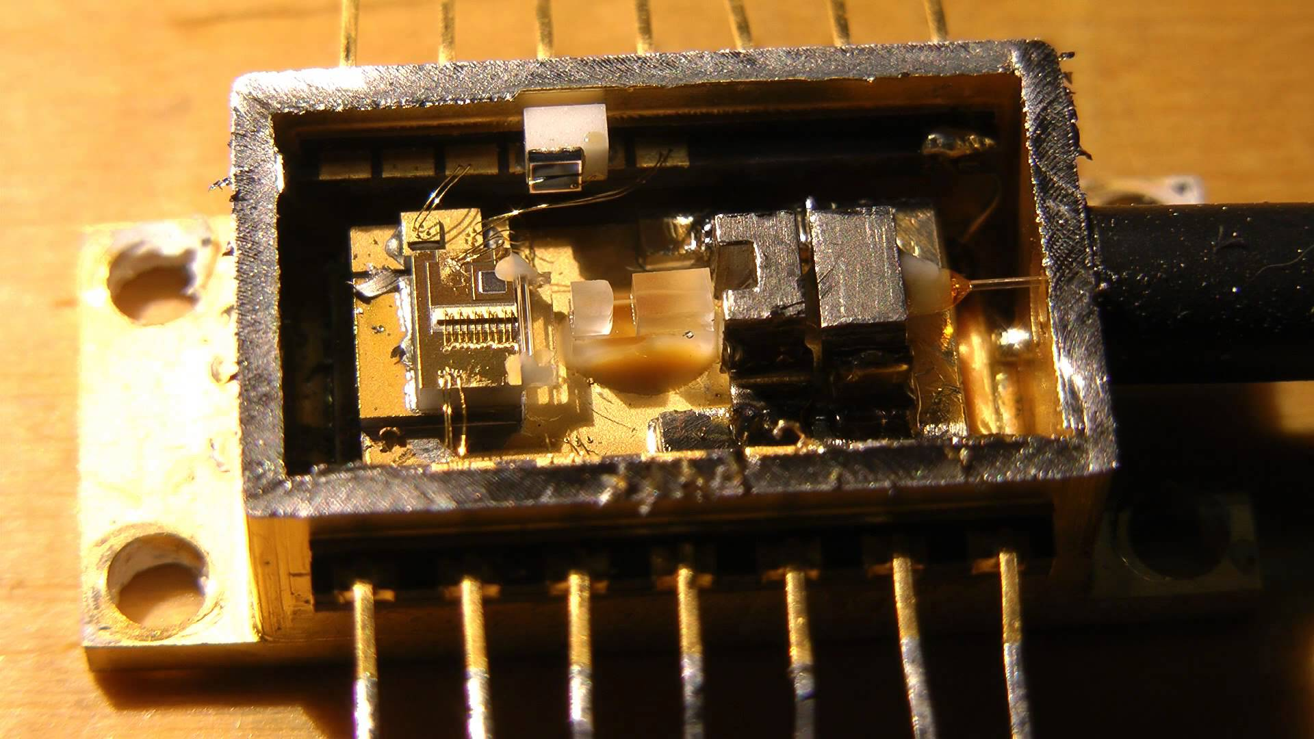
Laser Modulation Response
A distinct advantage of a semiconductor laser is its capability for direct modulation over GHz bandwidth.
The relaxation resonance frequency ω_{R} of a laser defines the maximum modulation frequency:
A: gain coefficient
P_{o}: photon density
τ_{p :} photon lifetime
Thus, in principle, ω_{R} can reach as high as 20-30 GHz (f_{R} ≈ 5 GHz).
To ↑ bandwidth, need ↑ω_{R},
i.e.
(1) ↑ gain coeff. A (use low operating T and proper choice of materials)
(2) ↑ photon density P_{o} (operating current >> threshold)
(3) ↓ photon lifetime τ_{p} (use short cavity and low facet reflectivity)
However, the modulation bandwidth is also limited by the packaging electronics.

Slide 31
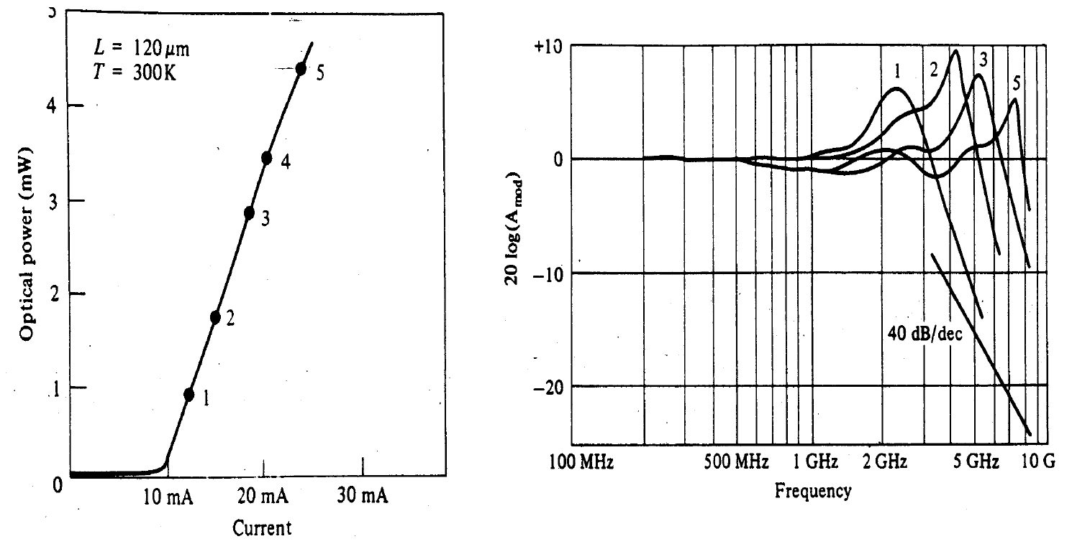
Laser Modulation Response (Measured)
Higher driving current → higher photon density → higher modulation frequency

Slide 32

Let’s Play!
Scan Me!
OR type the following
https://www.menti.com/ydes8jajvw
voting code 4676 4606

Slide 33
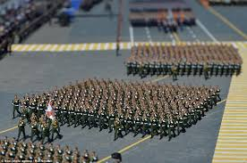
Laser vs. LED
Laser
Laser:
- Coherent (in phase)
- Narrow wavelength
- Collimated
- Higher power (usually)
LED / Light

Slide 34
Now we can explain some of the laser properties
Laser
Stimulated emission
Coherent radiation
Multi-mode and single mode
Narrow spectral width
High power
Threshold device
High efficiency
High modulation bandwidth
Short and long distant commun.
Relatively difficult to fabricate
Shorter lifetime
Expensive
Population inversion and cavity
Stimulated emission
Design, cavity
Stimulated emission and cavity
Amplification due to cavity with gain
Gain > Loss
Direct bandgap
Carrier density
Coherency

Slide 35
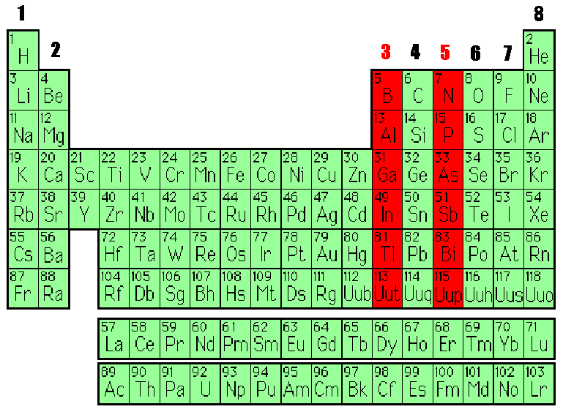
Commonly Used Laser - Semiconductor Lasers
Invented in 1962
Room temperature operation,1970
III-V elements, most commonly GaAs or InP
These are ‘exotic’ materials - fabrication expensive and complex
Size, reliability, efficiency, and wavelength range make them ideal for optical communications

Slide 36

Various Types of Semiconductor Lasers

Slide 37

Basic Laser Structure

Slide 38

Double Hetero-Structure Laser

Slide 39

Double Hetero-Structure Laser

Slide 40

Choice of Laser Materials: General
Properties of Optical Fibers
1st generation 0.8-0.9 μm, GaAs/AlGaAs (lowest loss)
2nd generation 1.3 μm (dispersion-free), InGaAsP/InP (Dispersion-shifted fiber)
3rd generation 1.55 μm, InGaAsP/InP (EDFA fiber amplifier)

Slide 41

Choice of Laser Materials: General
Bandgap energy E_{g} and lattice constant a for various III-V alloys of GaP, GaAs, InP and InAs.
Solid lines are for direct bandgap alloys whereas dashed lines for indirect bandgap alloys.
Regions between lines represent quaternary alloys.
The line from X to InP represents quaternary alloys In1-xGaxAs1-yPy made from In0.535Ga0.465As and InP which are lattice matched to InP.

Slide 42

Laser: Stripe Geometry

Slide 43

Laser Packaging

Slide 44


SEM Image of a Laser
http://www.novuslight.com/the-world-s-most-powerful-terahertz-laser_N2262.html

Slide 45

Photonic Integrated Circuits
IEEE Spectrum

Slide 46

Laser Packaging

Slide 47

Other Types of Laser – Fiber Laser
Mode Locked Fiber Laser generates pulses from a cavity.
For ultrashort pulse generation via active or passive mode locking.
Pulse duration in the order of 10⁻¹² -10⁻¹⁵ second.
Active methods typically involve using an external signal to induce a modulation of the intracavity light.
Passive methods do not use an external signal, but rely on placing some element into the laser cavity which causes self-modulation of the light

Slide 48

Other Types of Laser
Tunable Laser can be achieved by:
External laser cavity containing a tunable wavelength filter
e.g. Fabry-Perot filter, diffraction grating, electro-optic filter, acousto-optic filter
Multi-electrode DFB and DBR lasers
The filter/grating demultiplex or filter different wavelength according, and is tunable

Slide 49
Homework 1 is post in eLC
Check for deadline

Slide 50

Let’s Play!
Scan Me!
OR type the following
https://www.menti.com/fjkee9bzey
voting code 7858 9692

